Slide 1
Problem Identification
Big Mountain Resort has increased seasonal costs by $1.54 million due to a new chair lift.
Challenge: Develop a pricing and operations strategy that increases revenue per visitor by 10% or reduces costs by 5%, without lowering customer satisfaction below 85%.

Slide 2
Business Goals
- Improve profitability through data-driven pricing.
- Maintain customer satisfaction at or above 85%.
- Avoid major infrastructure changes or additional capital investment.
- Implement strategy within 12 weeks before ski season launch.

Slide 3
Recommendation and Key Findings
Recommendation: Implement dynamic pricing strategy and optimize operations.
- Raise prices on peak days and offer midweek discounts.
- Promote multi-day and season passes.
- Operational adjustments to reduce lift wait times.
Key Finding: Satisfaction strongly correlates with wait times; revenue varies significantly by ticket type.

Slide 4
Data and Preprocessing
- Cleaned and wrangled visitor, ticket, and satisfaction data.
- Engineered features: ticket type, time of visit, lift usage, etc.
- Prepared datasets for regression and classification models.

Slide 5
Modeling Approach
- Revenue Prediction: Linear Regression.
- Satisfaction Classification: Random Forest, Logistic Regression.
- Metrics Used: RMSE, Accuracy, Precision, Recall.
- Random Forest yielded best accuracy in predicting satisfaction.

Slide 6
Scenario Modeling
- Simulated impact of pricing changes.
- Weekday discounts helped redistribute traffic.
- Estimated +10% revenue per visitor with minimal drop in satisfaction.
- Visualization confirmed visitor peaks on weekends and holidays.

Slide 7
Summary and Conclusion
- Data-driven pricing strategy can offset increased operating costs.
- Operational tweaks enhance satisfaction without additional investments.
- Strong business case for dynamic pricing and targeted promotions.
- Future work: real-time monitoring and advanced forecasting models.

Slide 8
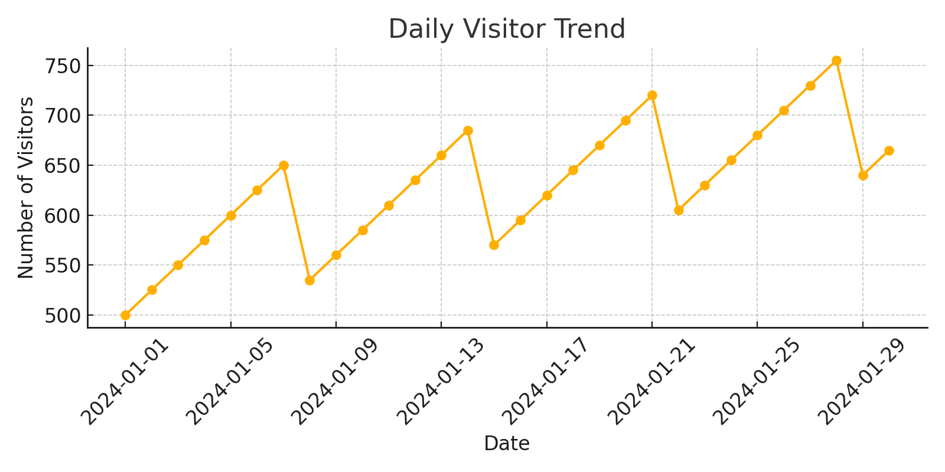
Daily Visitor Trends

Slide 9
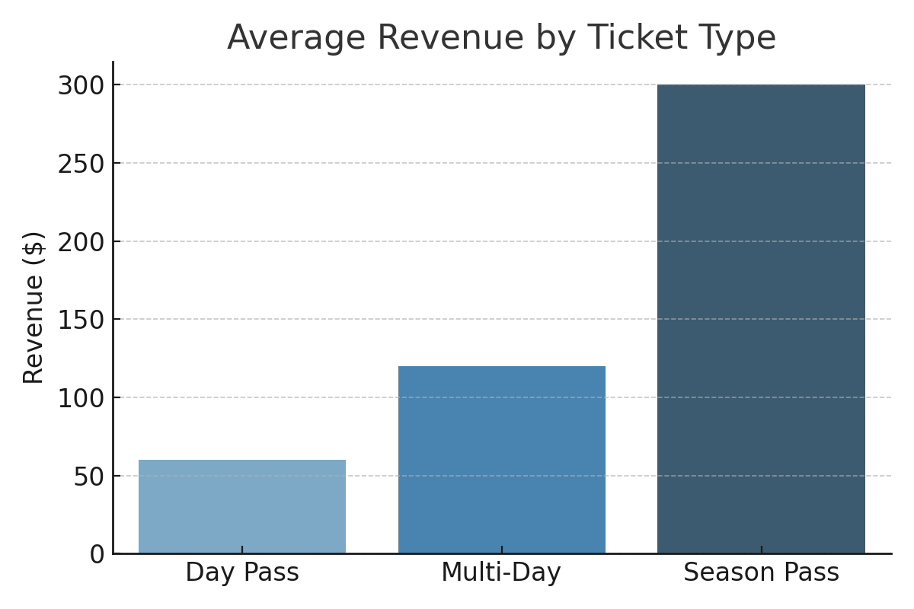
Revenue by Ticket Type

Slide 10
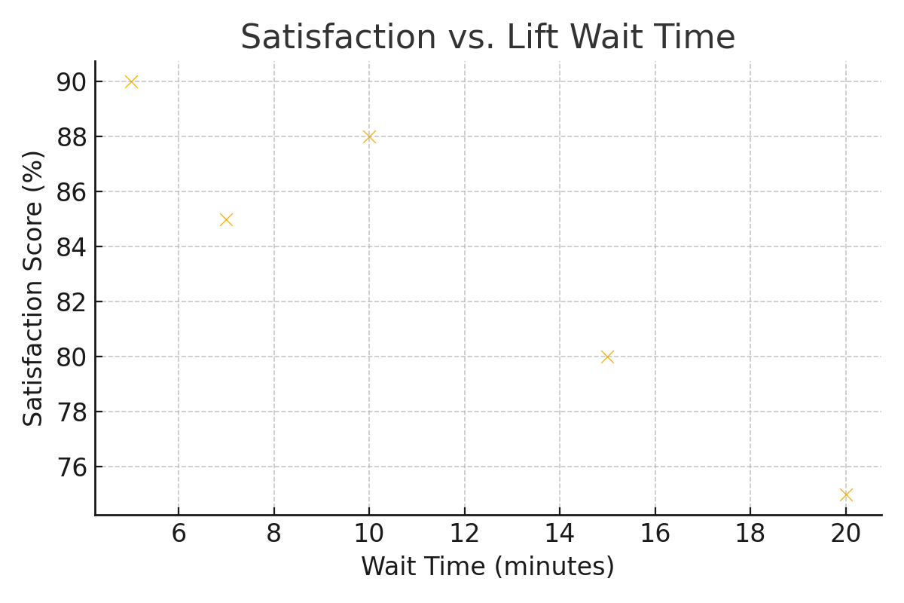
Satisfaction vs. Wait Time

